Slide 1
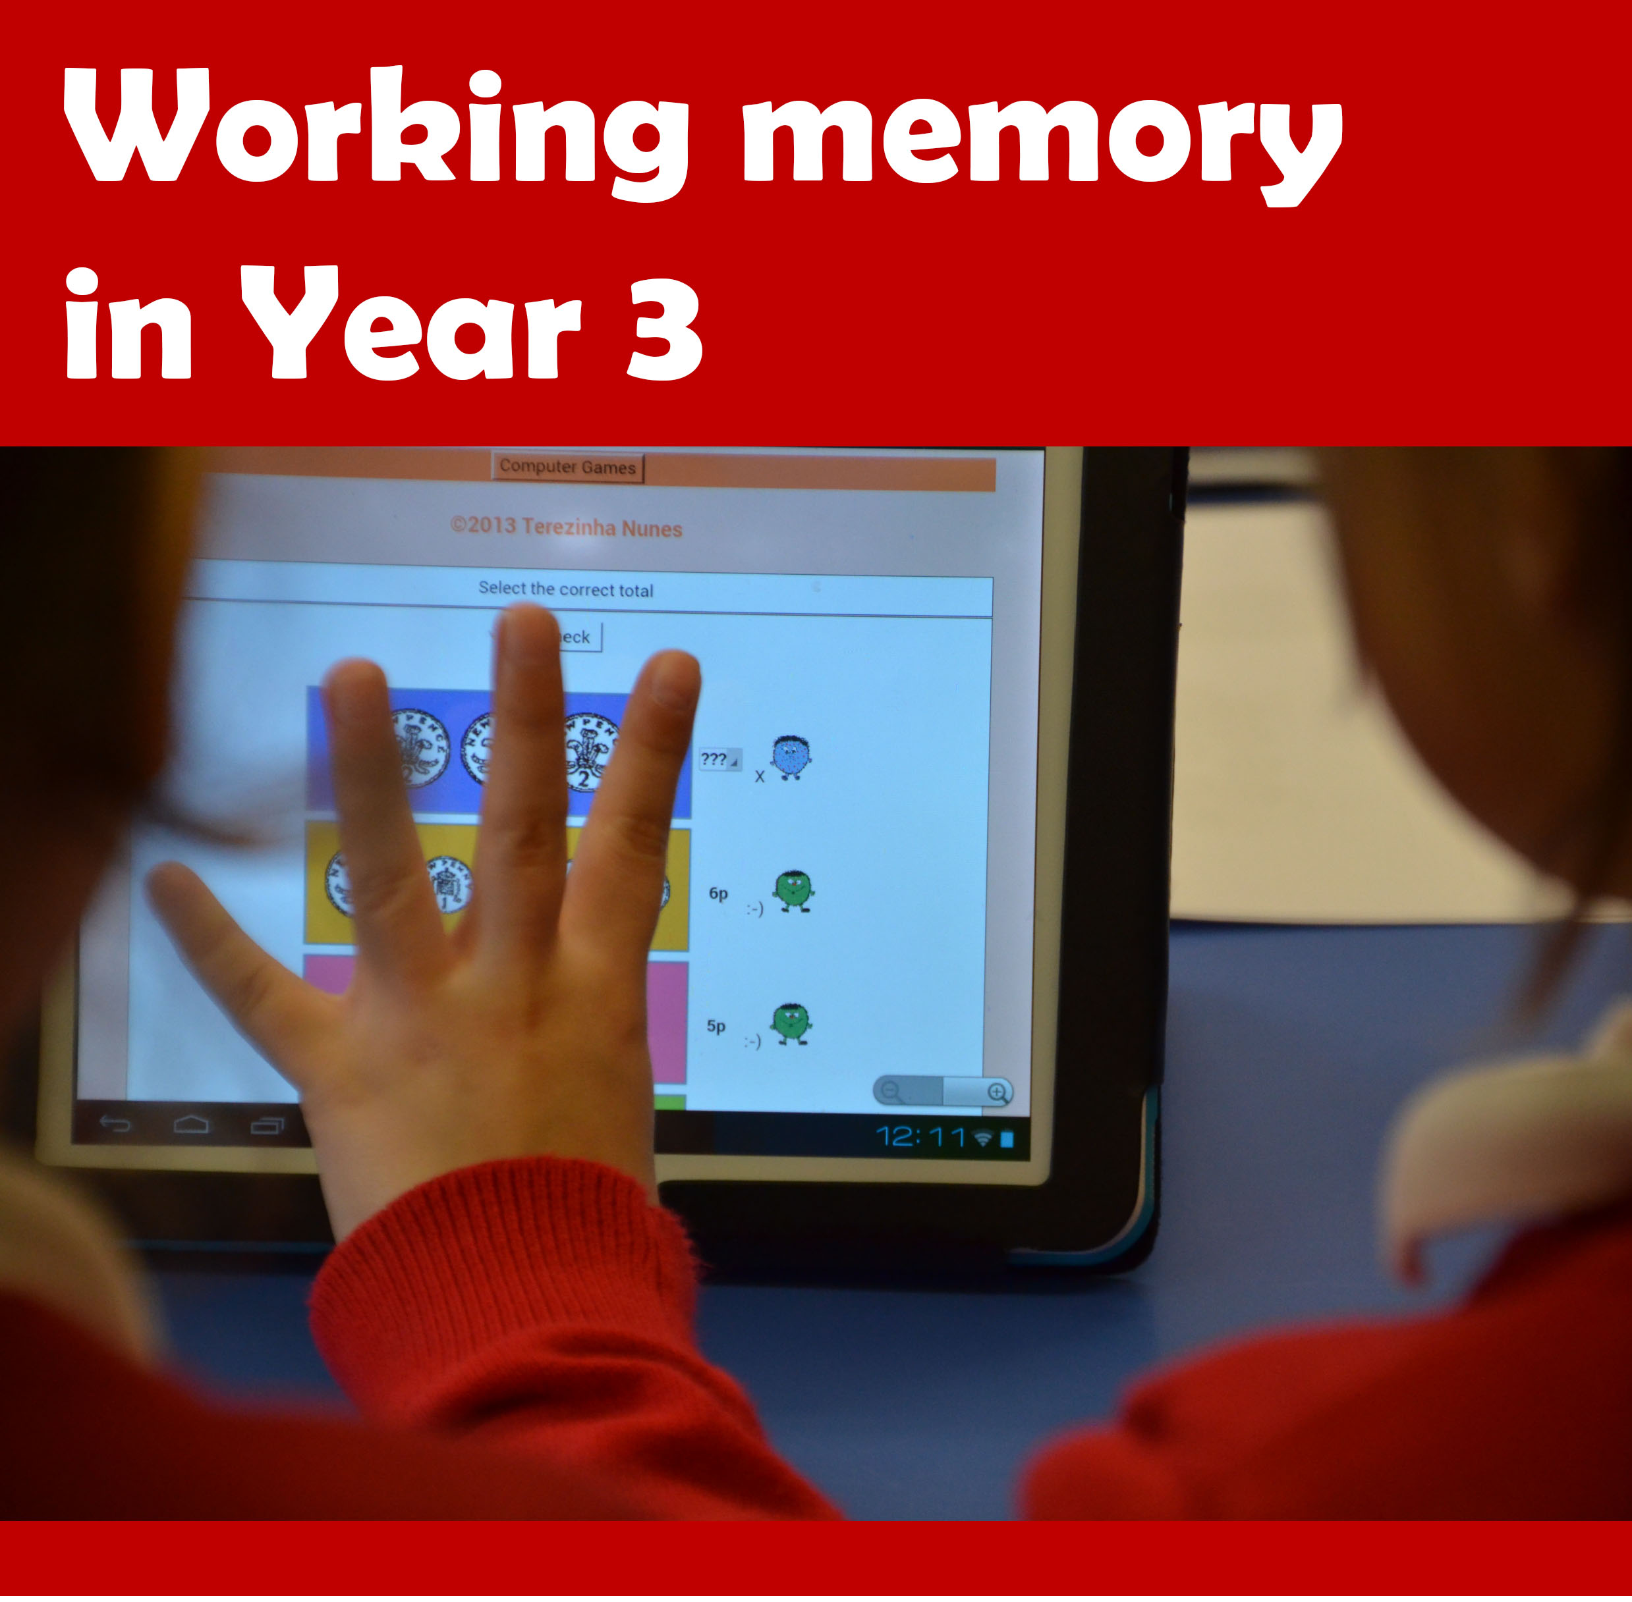
Working memory and arithmetic skills in Year 3
The WM+A programme
Working Memory (WM) underpins many activities that children do at school, particularly arithmetic. Children struggling with mathematics can benefit from increasing their working memory capacity. The WM+A programme aims to improve children’s WM and understanding of numbers and arithmetic operations. Your school can participate in this exciting project funded by the EEF.

Slide 2
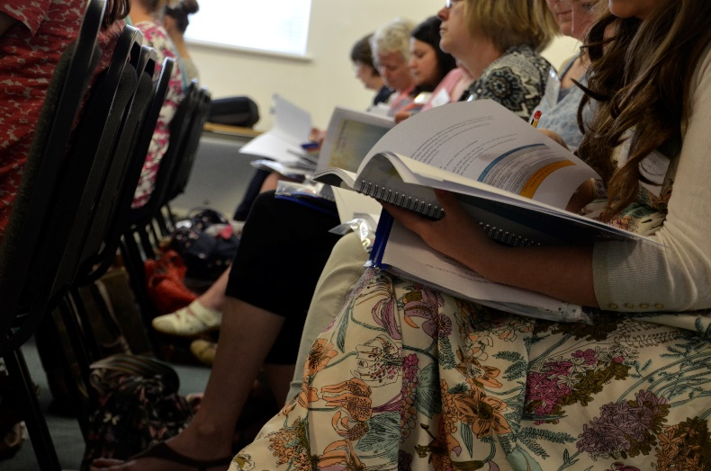
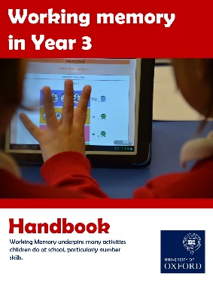
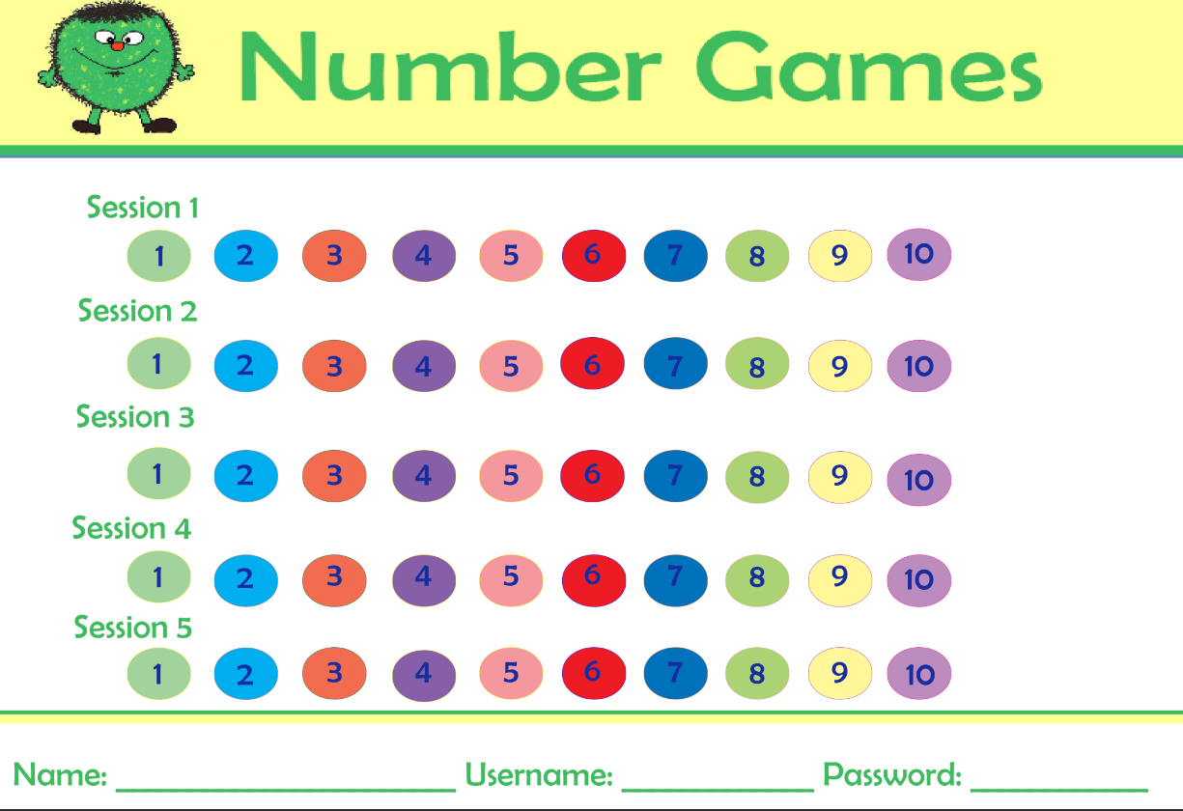
Working memory and number skills
in Year 3
The WM+A programme is for children needing extra support in arithmetic at the end of KS1. Their difficulties could be related to their WM capacity. The WM+A programme was found effective in improving children's WM, arithmetic and attention in class in a large scale project funded by the EEF. In this project, Oxford University will work together with RAND to evaluate how the programme works when it is made available to a larger number of schools and children. The cost of the programme is free to all schools who participate.
Evidence of success:
The WM activities were found to improve children’s WM in three previous studies.
The number sense activities were found to improve arithmetic attainment in three studies.
The WM+A programme combines the two sets of activities and led to improvements in WM, arithmetic and attention in class in a large scale study.
The programme offers:
Training for TAs and link teachers
Two full days of training with specifically trained instructors
Support for implementation by the Oxford team and a school nominated link teacher.
Professional development
Ready to use materials
A set of interactive activities to be used with the children by specifically trained TAs
TAs guide the children's use of memory strategies
A set of computer games to be played independently by the children to consolidate the use of memory strategies.
Materials ready to use
Total implementation time
Five hours per week for 10 weeks are required for a TA to deliver the programme to 10 children.
What schools will need to do
Register their interest.
Schools will nominate a TA and a link teacher who will attend the training days.
TAs will need two computers/laptops/tablets to deliver the sessions, one with internet access.
Commit to implement the programme regularly (as above).
Link teacher to provide support for TA and to liaise with Oxford team.
Agree to randomization and to co-operate with the independent evaluators throughout the project. If your school is allocated to the control group, you would not receive the programme, but you would still need to co-operate with the evaluation until the end of the trial. Control school will receive £1000, which could be used to purchase the programme at the end of the trial.
Your trainer will be
Andy Tynemouth | Primary Maths Adviser Babcock LDP Second Floor | Milford House | Pynes Hill | Exeter | Devon | EX2 5GF Tel: +441392880763 ext. 880763 | Andy.Tynemouth@babcockinternational.com www.babcockldp.co.uk

